Slide 1
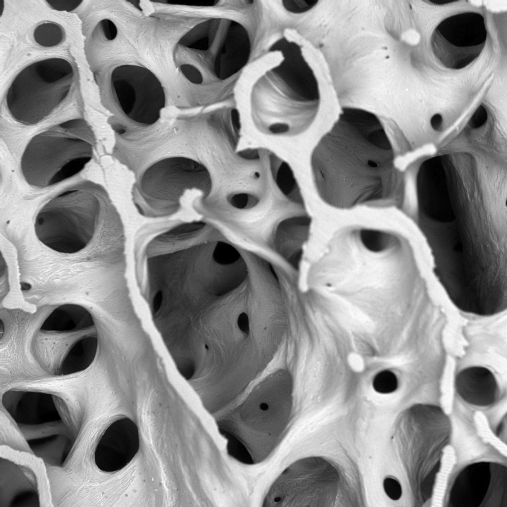
Normal bone architecture in 3rd lumbar vertebra of 30 year old woman marrow and other cells removed
Alan Boyde, QMUL

Slide 2
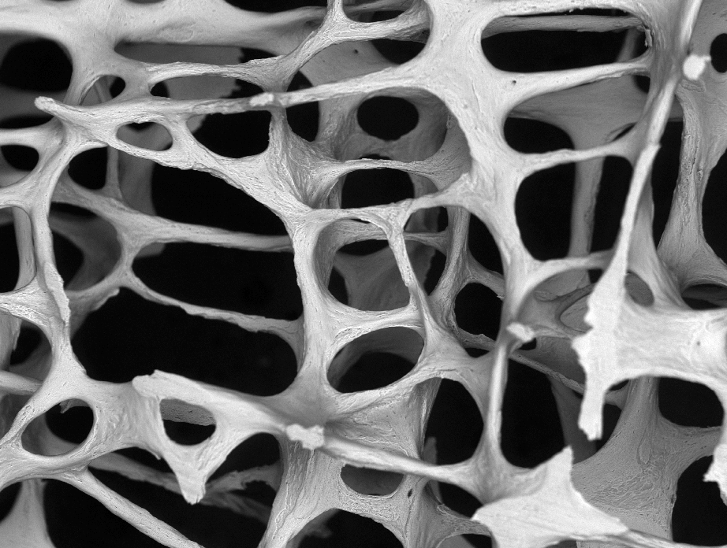
Osteoporotic bone architecture in 3rd lumbar vertebra of 89 year old woman marrow and other cells removed
Alan Boyde, QMUL

Slide 3
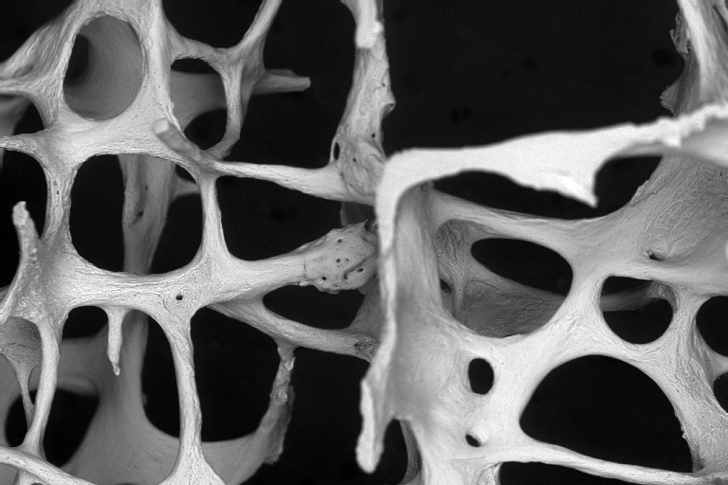
Osteoporotic bone architecture in 3rd lumbar vertebra of 89 year old woman marrow and other cells removed
Alan Boyde, QMUL

