Slide 1
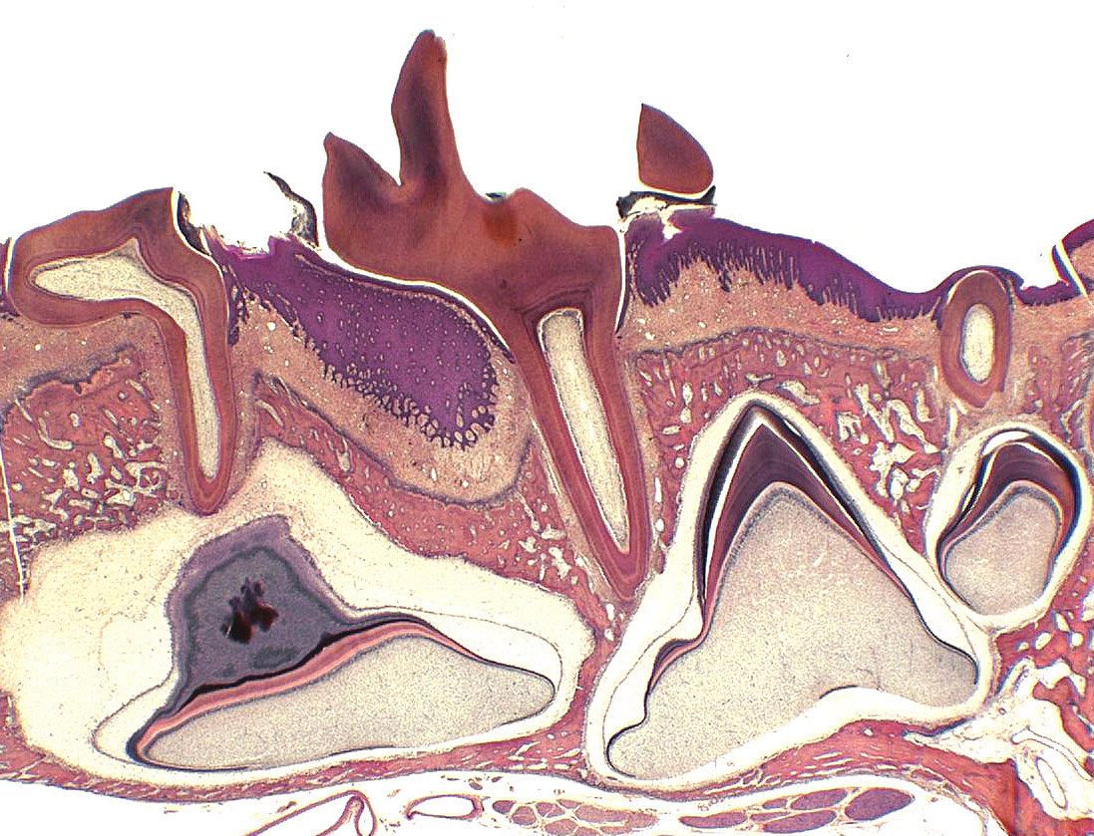
Tooth eruption
low power section of developing jaw
1 mm
Notes:
1

Slide 2
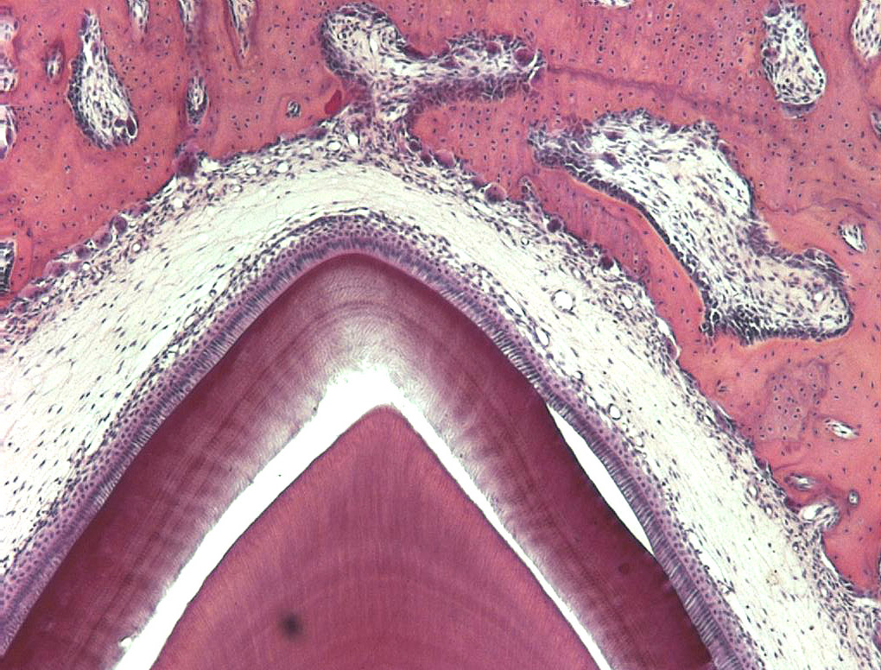
Tooth eruption
remodelling of alveolar bone to accommodate developing tooth

Slide 3
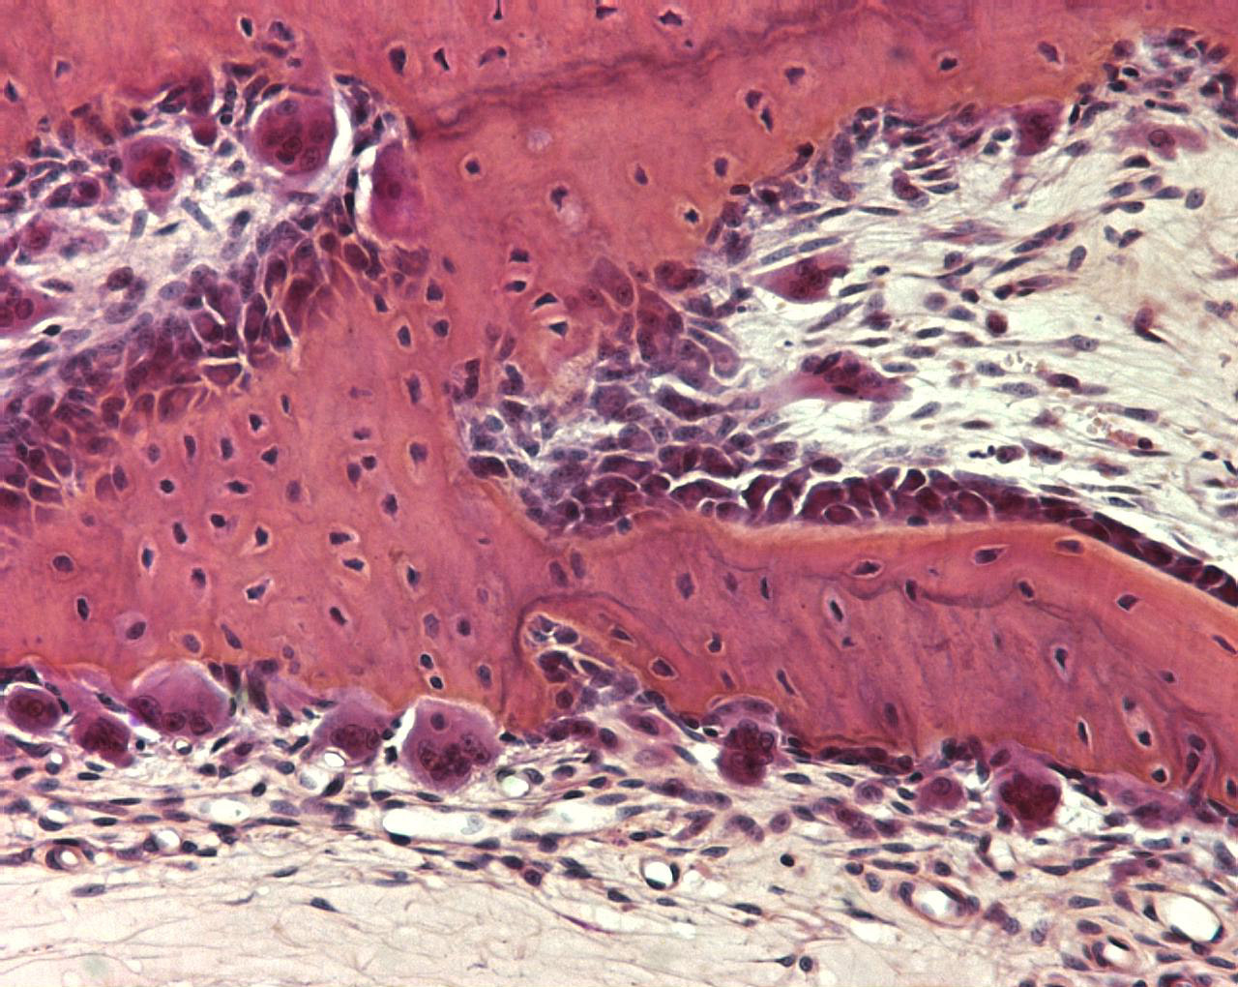
Bone cells
osteoclasts resorbing bone
osteocytes entombed in bone
osteoblasts forming bone

