Slide 1
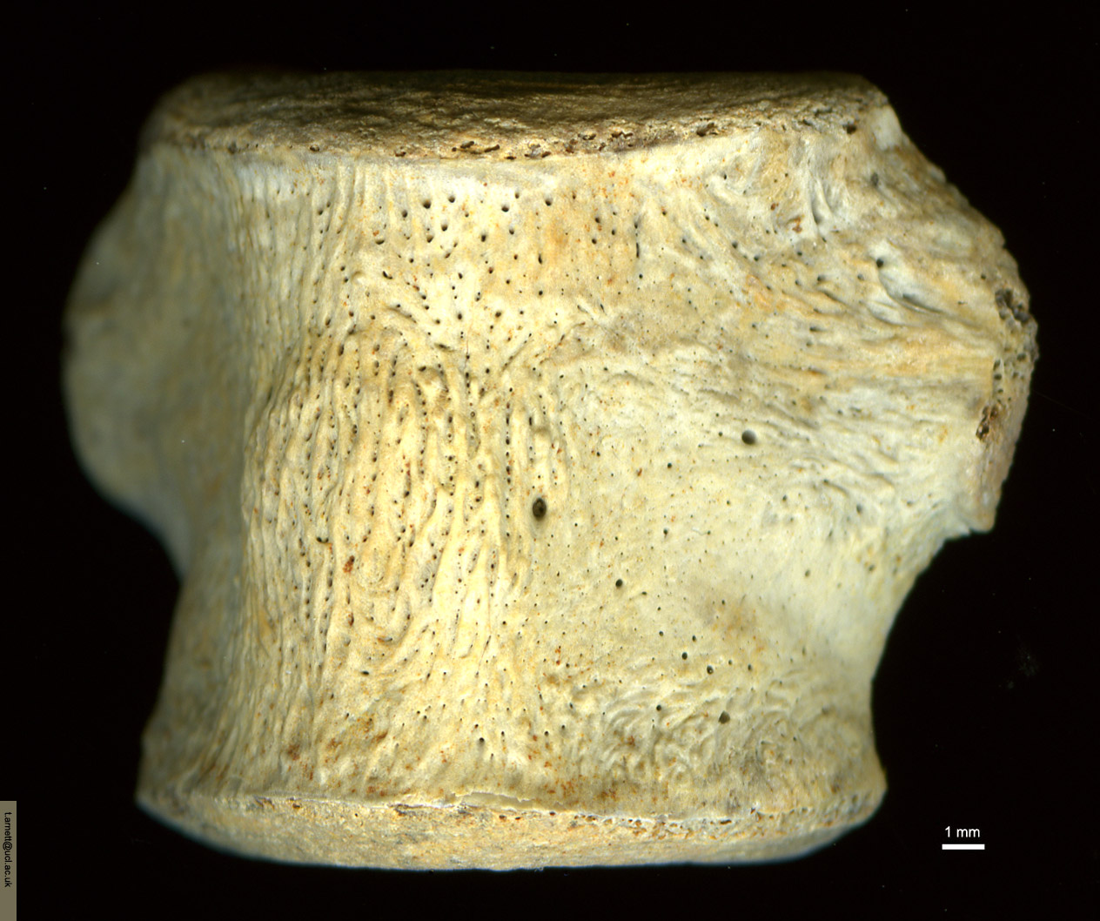
Dinosaur tail vertebra (100 Myr)
- note vascular channels

