Slide 1
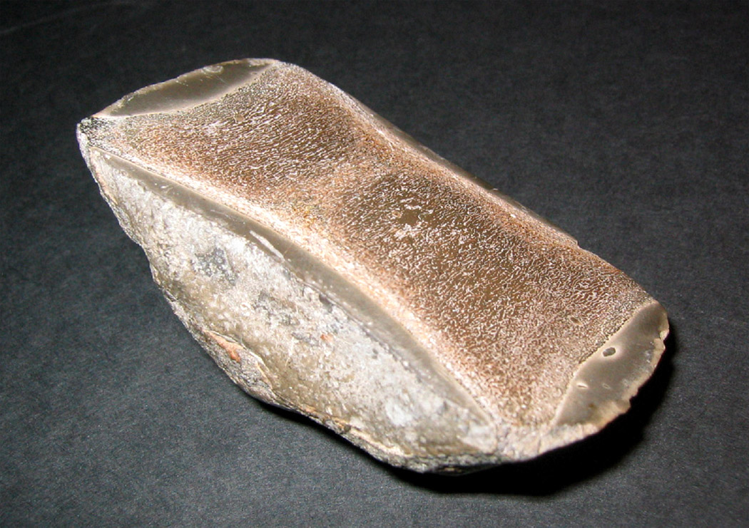
Fossil bone – small vertebral body of ichthyosaur
Whitby, UK - Jurassic (~180 M yr)

Slide 2
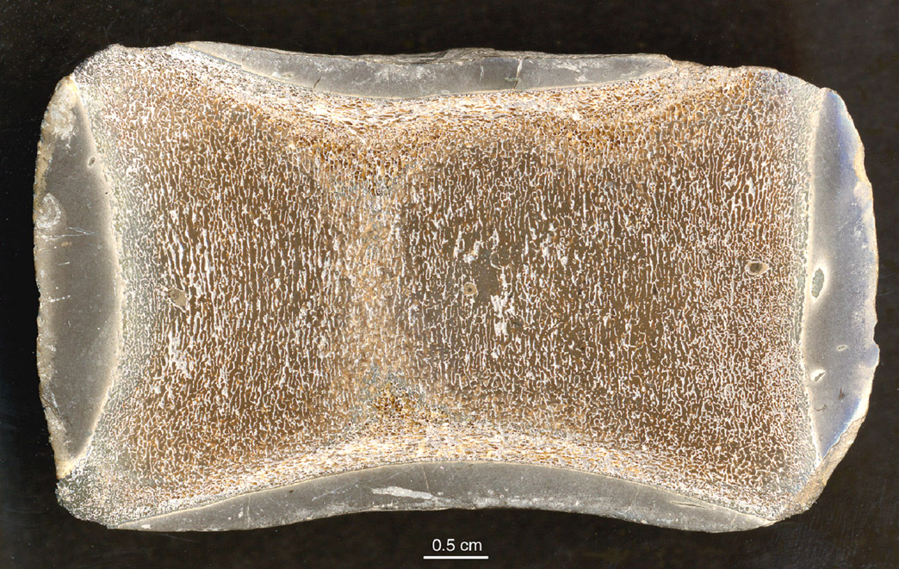
Ichthyosaur vertebra

Slide 3
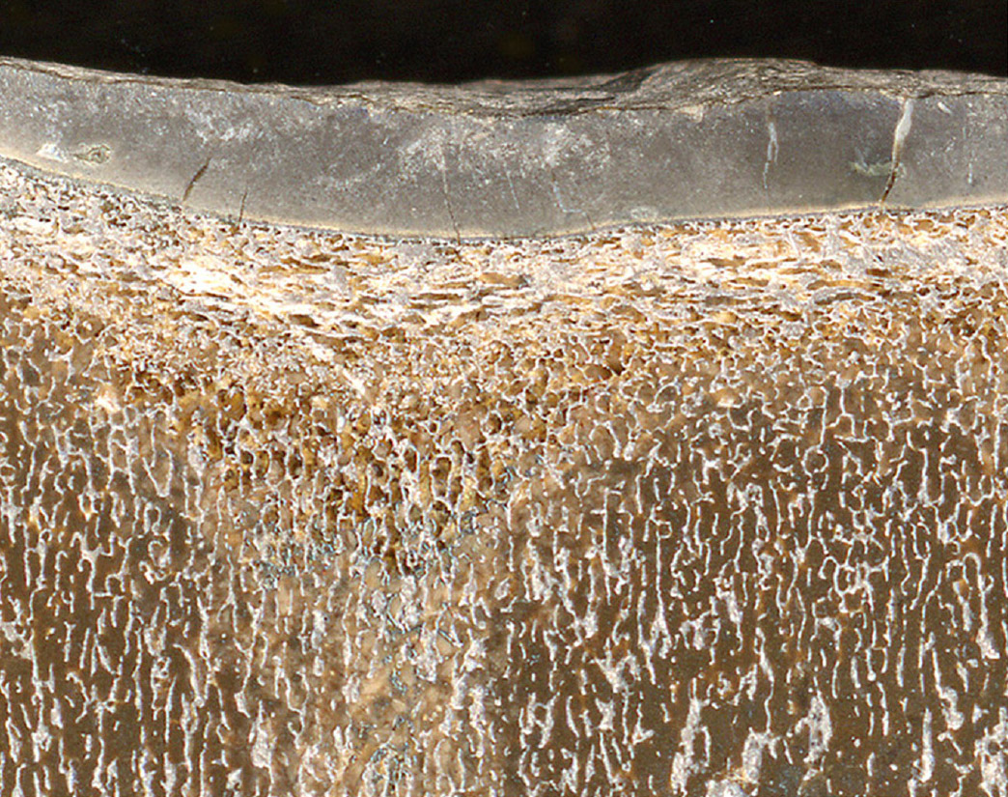
Ichthyosaur vertebra
preservation of trabecular architecture in stone

