Slide 1
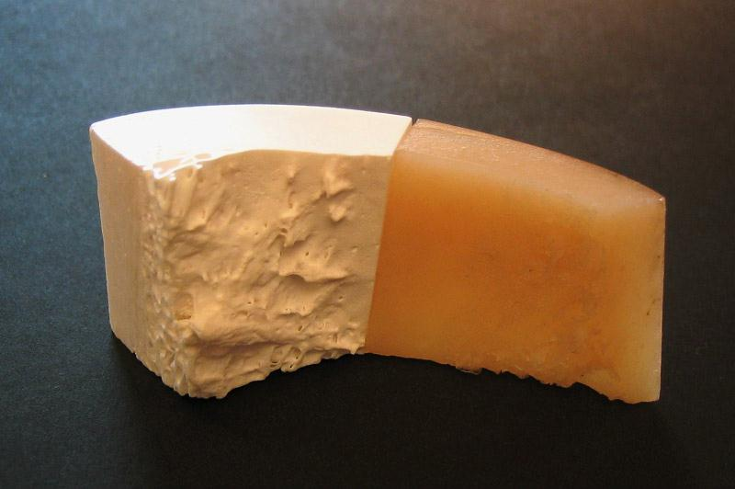
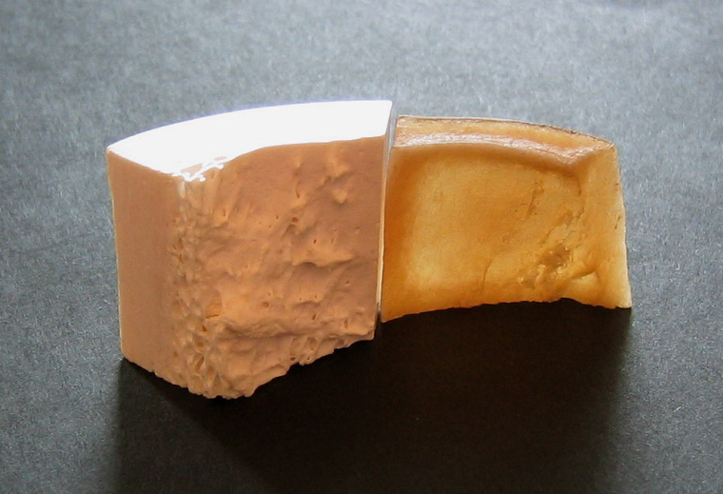
Bone composition
bone is made of mineral + organic (mainly collagen) components
Treated with hydrochloric acid to dissolve mineral ( Ca₁₀(PO₄)₆(OH)₂ )
leaves collagen component intact
Treated with bleach (hypochlorite) to digest collagen
leaves mineral component intact
Collagen shrinkage on drying

